Slide 1
RCSCC Centurion
Summer Training Presentation
Lt(N) Jeremy Kennedy
09 January 2018

Slide 2
Why Summer Training?
Skill development
Independence and accountability
Teamwork and camaraderie
Travel and new experiences
Training bonus
FUN!

Slide 3
Selection Process
Eligible cadets submit application (paper form)
Participant Application (PA) initiated by corps staff (online) – NLT 31 March
Cadets selected to attend a Cadet Training Centre are done so based on the recommendations of the corps Commanding Officer
Regional Cadet Support Unit Area Staff will make the final selections and publish the decision to the corps

Slide 4
Travel
Return transportation is provided
All travel is co-ordinated by the Regional Movements Officer
In-region courses typically travel the day before course start and depart day after graduation
More time may be required for out of region travel

Slide 5
Sample Daily Routine
0600 – Wakey Wakey
0610 – Morning PT
0645 – Breakfast
0730 – Morning Divisions
0830 – Training begins
1200 – Lunch
1300 – Afternoon training begins
1700 – Supper
1800 – Evening Activities
2000 – Secure from training
2200 – Lights out

Slide 6
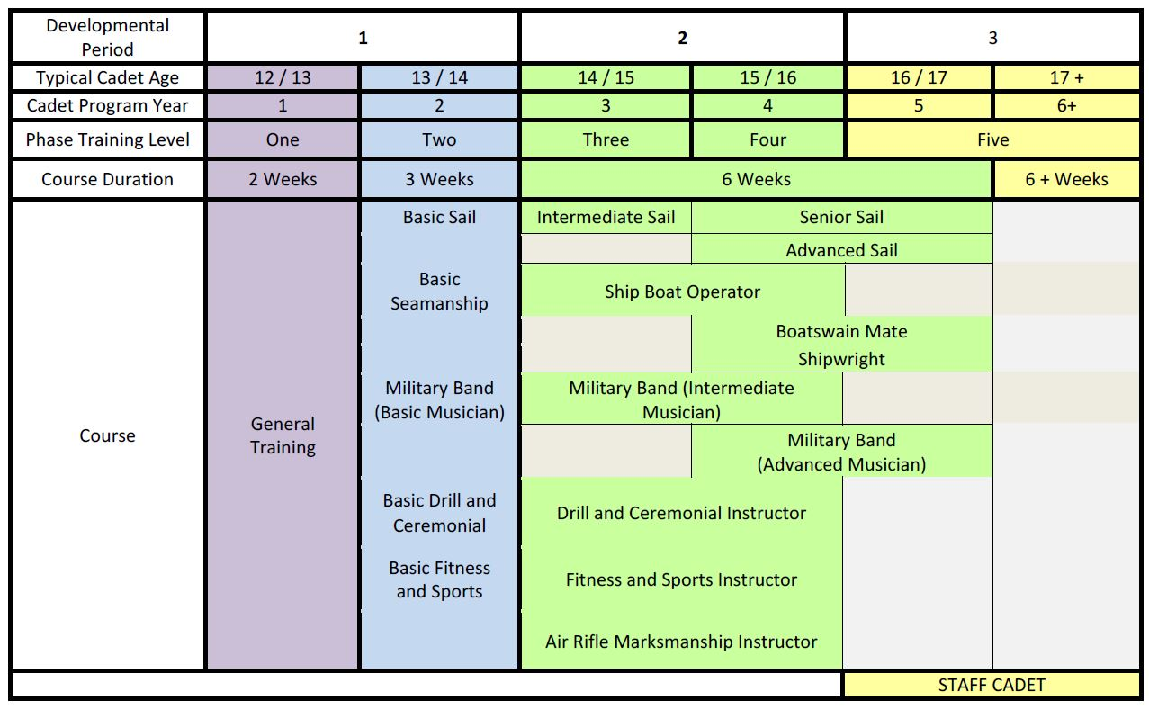
Courses Offered

Slide 7
Joining Instructions
Extremely important to read
Published in Spring
Specific for each Cadet Training Centre
Answers all the questions you need to prepare
  Kit list
  Contact #’s
  Laundry arrangements
  Etc.

Slide 8
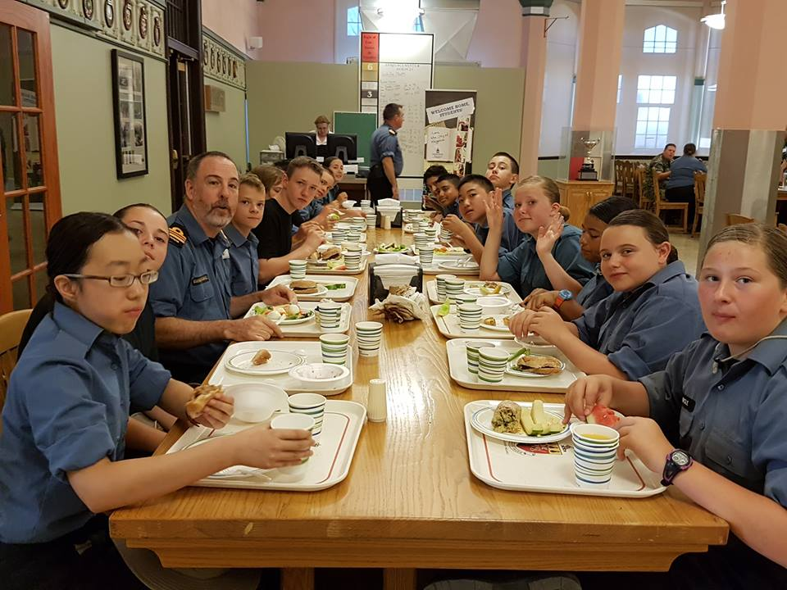
General Training – Two Week Course
July 9-21, July 23-Aug 4, Aug7-18
Introduction to camp life
Marksmanship
Sailing
Music
Seamanship
Drill
Sports/swimming

Slide 9
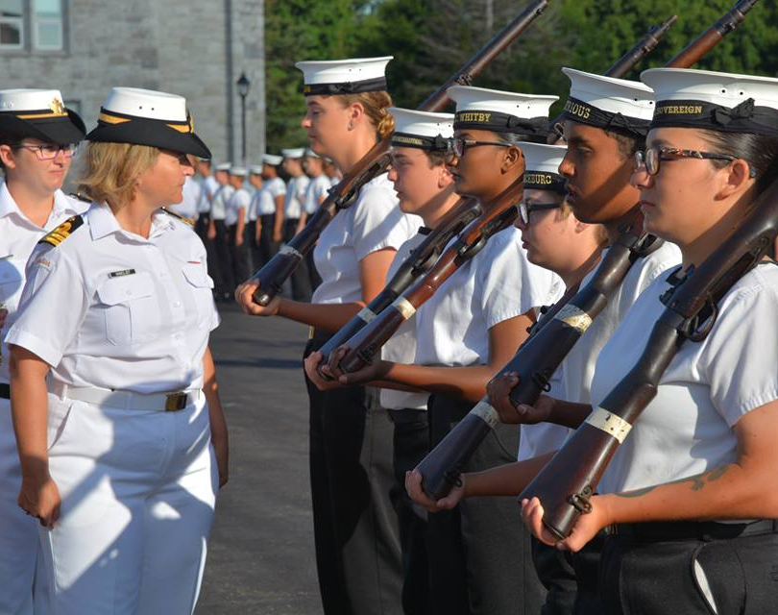
Basic Drill and Ceremonial – Three Week Course
July 9-28, July 31-August 18
Marching drill
Drill with arms
Field gun drill
Colour party drill

Slide 10
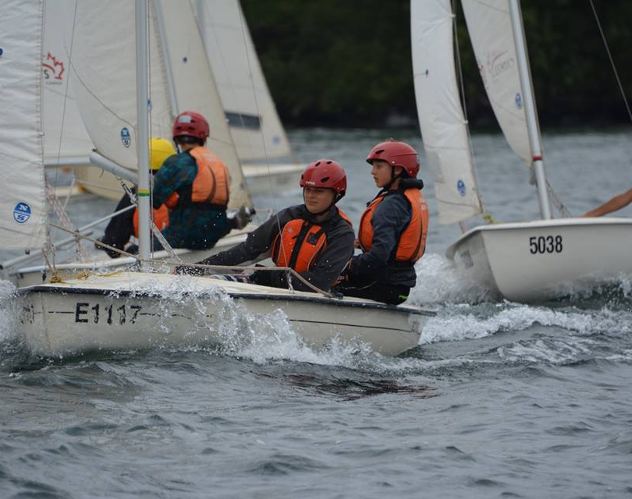
Basic Sail – Three Week Course
9 July – 28 July, 31 July – 18 August
Dinghy sailing
CANSail 2

Slide 11
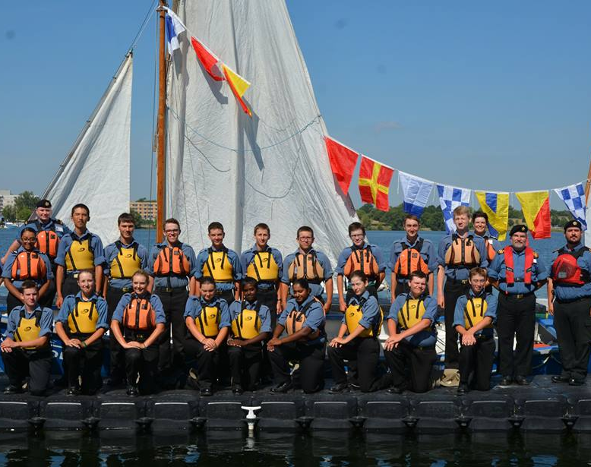
Basic Seamanship – Three Week Course
9 July – 28 July, 31 July – 18 August
Ropework
Block & Tackle
Whaler training

Slide 12
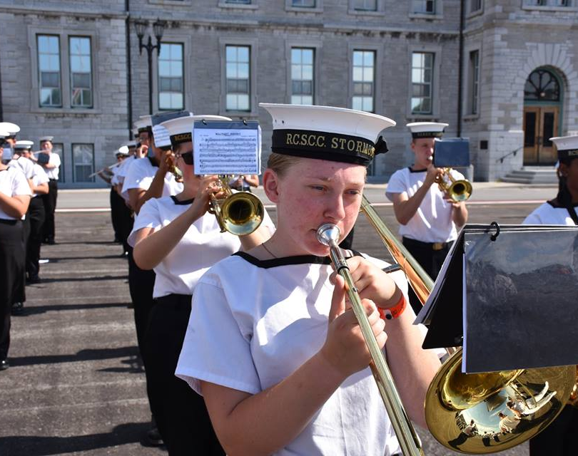
Basic Musician – Three Week Course
9 July – 28 July, 31 July – 18 August
Music Proficiency level Basic

Slide 13
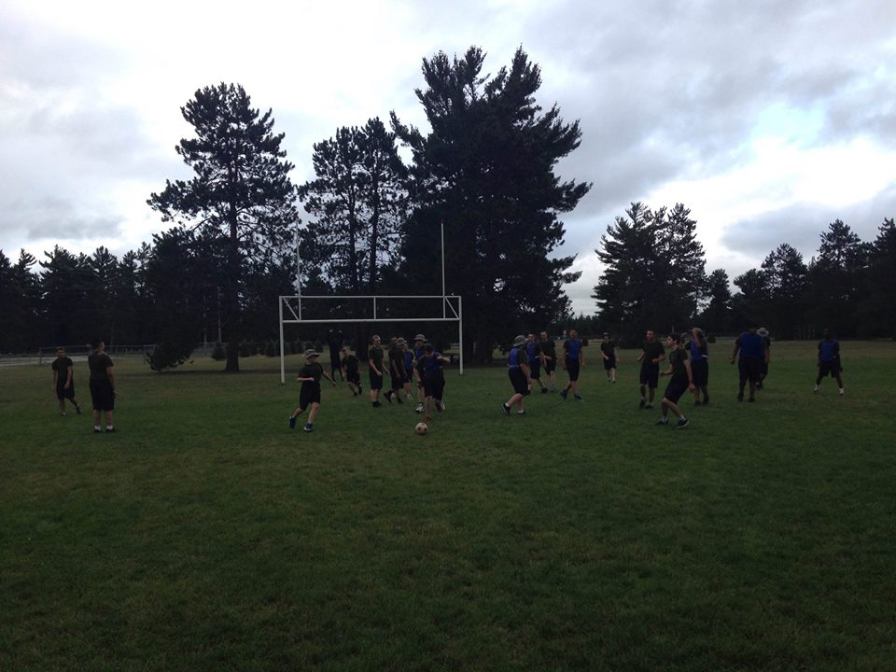
Basic Sports and Fitness – Three Week Course
9 July – 28 July, 31 July – 18 August
Team Sports
Cadet Fitness Assessment

Slide 14
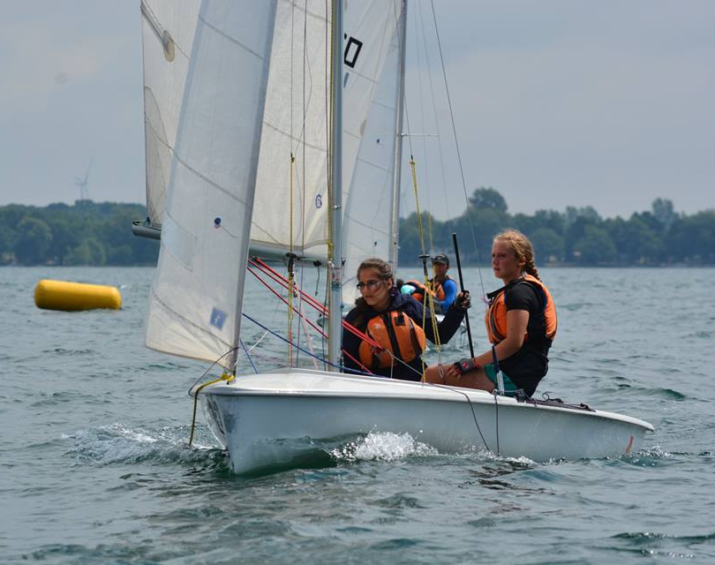
Intermediate Sail – Six Week Course
9 July – 18 August
CANSail 3
PCOC
SCOP Module 3
VHF ROC/M
First Aid

Slide 15
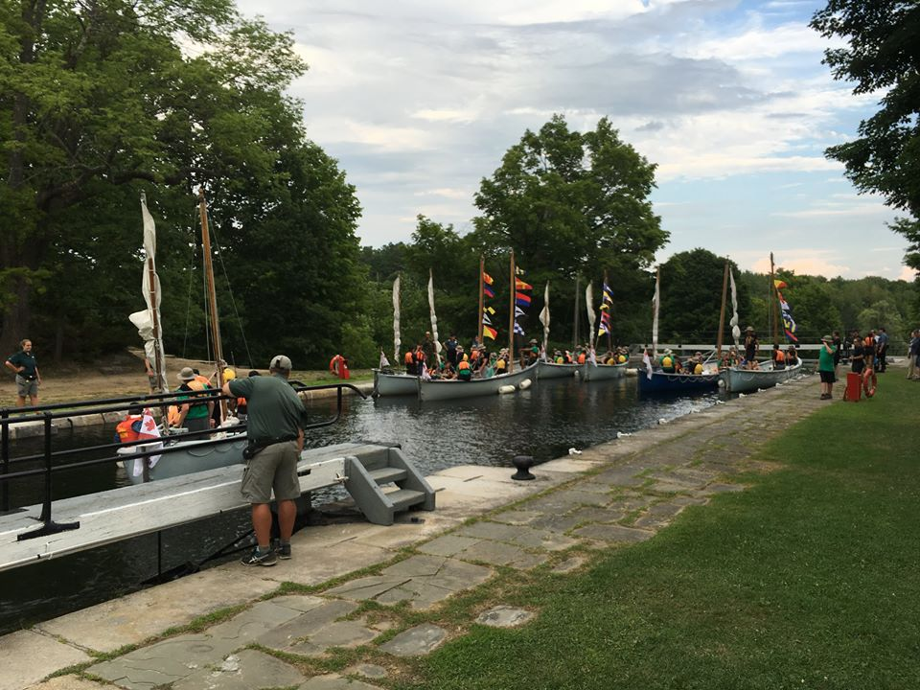
Ship’s Boat Operator – Six Week Course
9 July – 18 August
Whaler Training
Powerboat training
PCOC
VHF ROC/M
First Aid

Slide 16
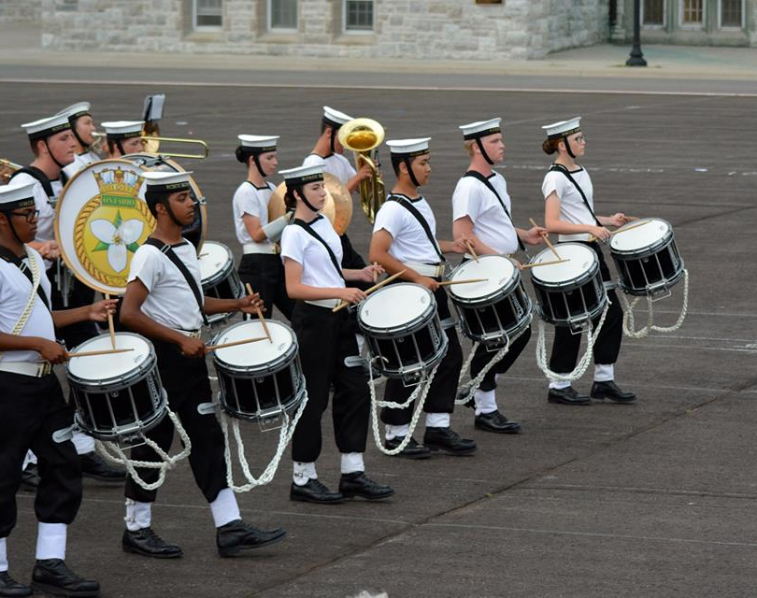
Intermediate Musician – Six Week Course
9 July – 18 August
Music Proficiency Level 1+
First Aid
Parades

Slide 17
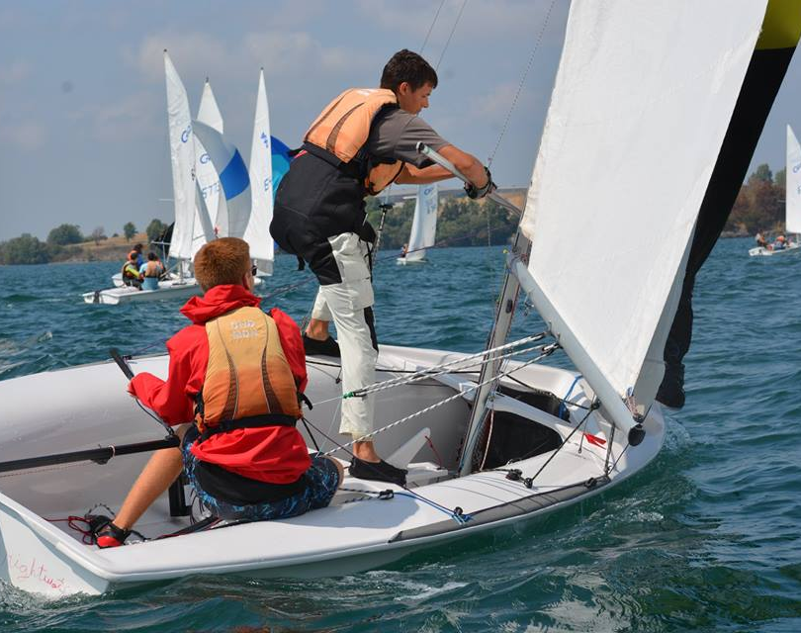
Senior Sail – Six Week Course
9 July – 18 August
CANSail 4/5
Trapeze and Spinnaker
Coach Boat Safety

Slide 18
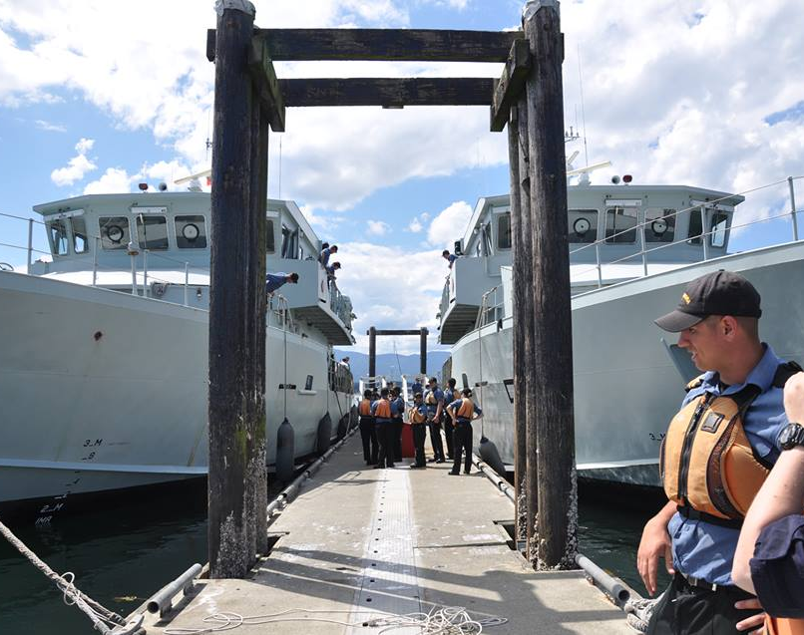
Boatswain’s Mate – Six Week Course
9 July – 18 August
SCTV Training
Damage Control
Advanced Seamanship

Slide 19
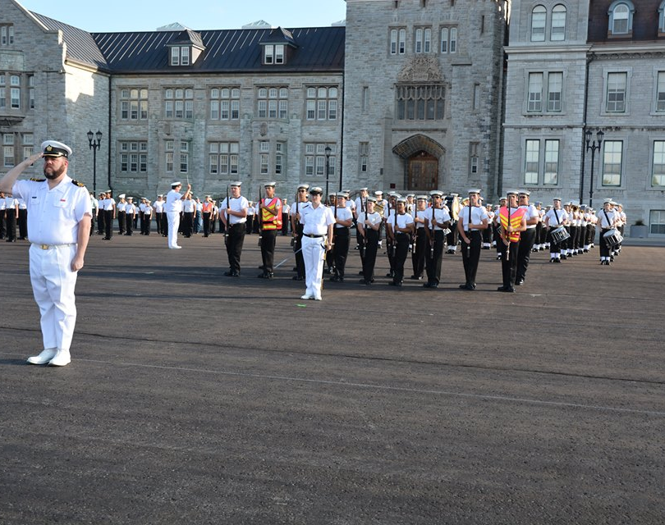
Advanced Musician – Six Week Course
9 July – 18 August
Music practice
Music Theory
Parades
Proficiency up to Level 5

Slide 20
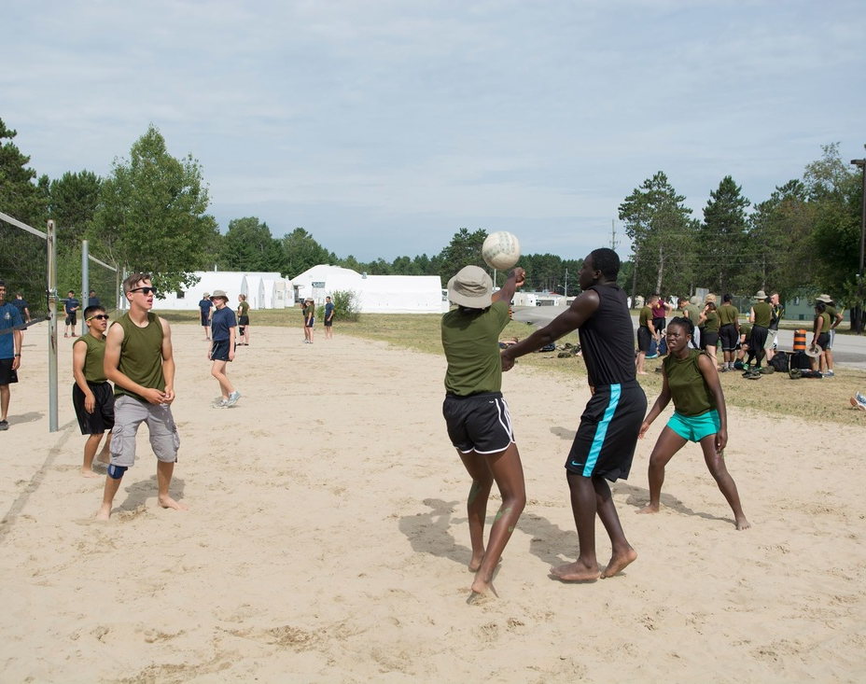
Fitness and Sports Instructor - Six Week Course
9 July – 18 August
Sport and Fitness Instructor training
Leadership of sporting activities
First Aid

Slide 21
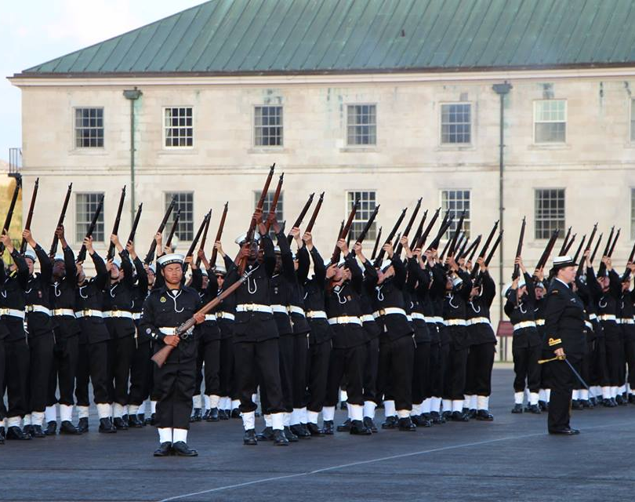
Drill and Ceremonial Instructor – Six Week Course
July 9- August 18
Excellence in Drill and Ceremonial
Drill Instructor Training

Slide 22
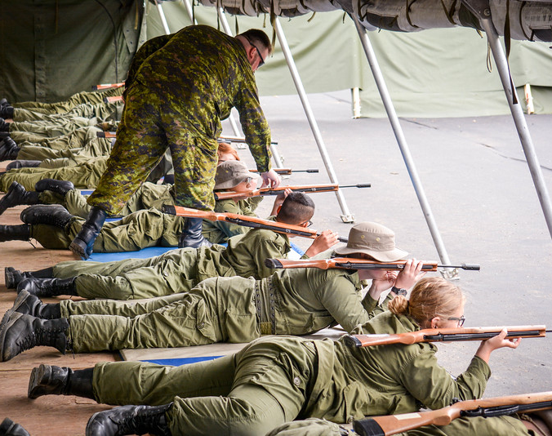
Air Rifle Marksmanship Instructor – Six Week Course
9 July – 17 August
Marksmanship practice
Marksmanship coaching
Summer Biathlon
First Aid

Slide 23
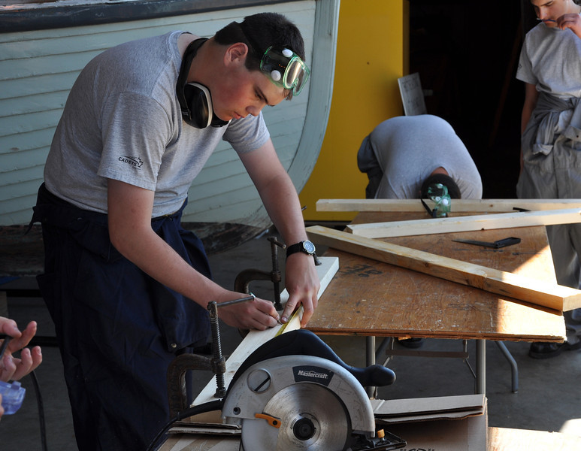
Shipwright – Six Week Course
July 9 – 18 August
Woodworking
Fibreglass Work
Small Engine Maintenance

Slide 24
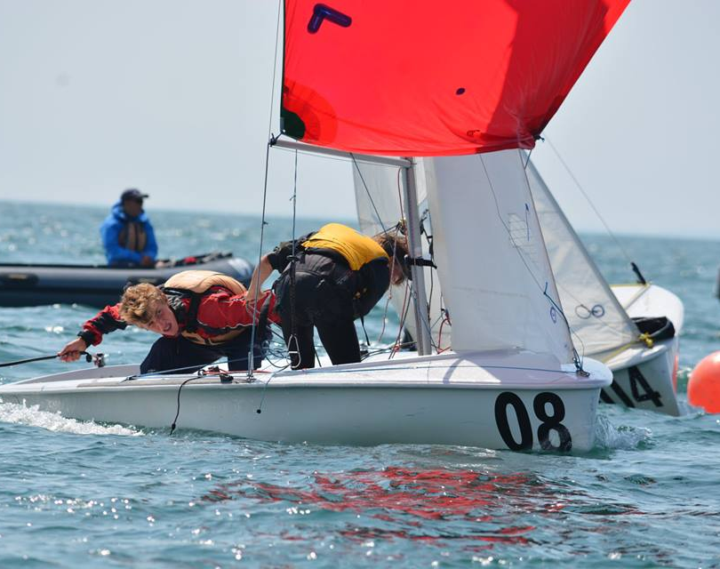
Advanced Sail – Six Week Course
9 July – 18 August
CANSail 6
Trapeze and Spinnaker 2
Travel to Regattas

Slide 25
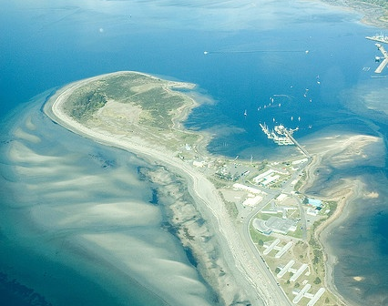
HMCS Quadra
Located in Comox, British Columbia
1000 cadets
Ship’s Boat Operator
Boatswain’s Mate
Shipwright

Slide 26
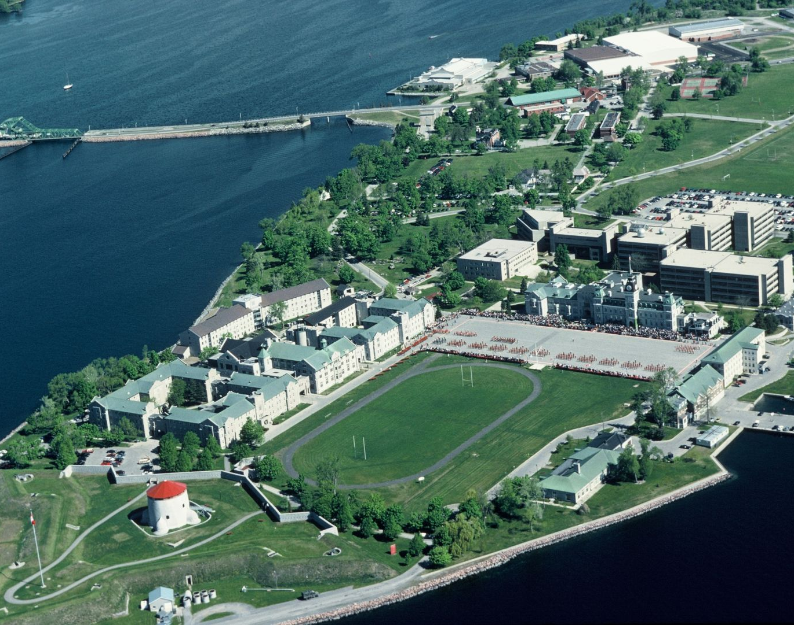
HMCS Ontario
Located at Royal Military College
800 cadets trained each summer
General Training
Music (Basic, Intermediate, Advanced)
Basic Seamanship
Ship’s Boat Operator
Basic Drill and Ceremonial
Drill and Ceremonial Instructor
Sail (Basic, Intermediate, Senior, Advanced)

Slide 27
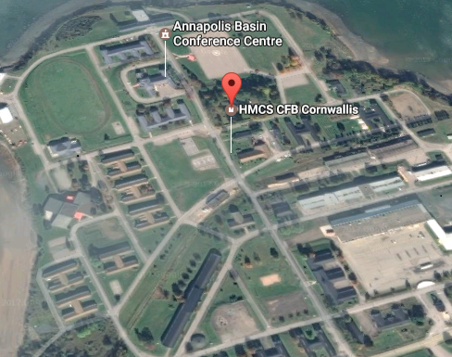
HMCS Acadia
Located in Cornwallis, Nova Scotia
1500 cadets
Boatswain’s Mate

Slide 28
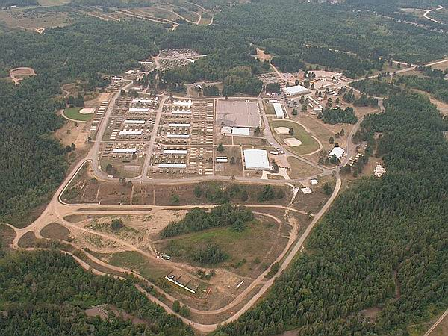
Blackdown CTC
Located at Canadian Forces Base Borden
2500 cadets
Basic Fitness and Sports
Fitness and Sports Instructor

Slide 29
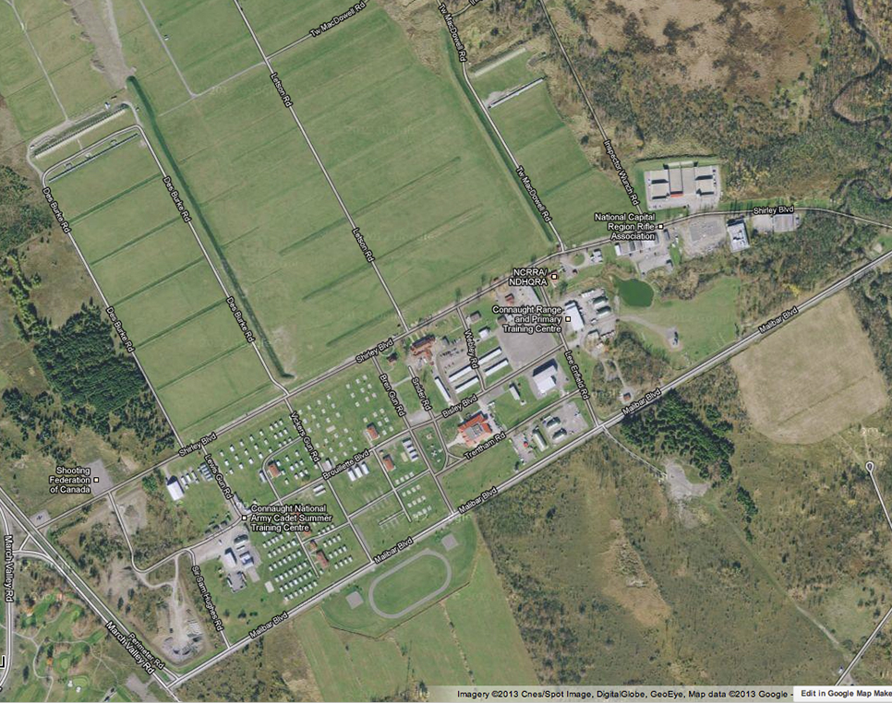
Connaught CTC
Located in Ottawa, Ontario
500 cadets
Air Rifle Marksmanship Instructor

Slide 30
Questions?

